Slide 1

What are we going to see in this session?
Ansible Installation
What will be installed?
Version Management
Infrastructure Prerequisites
Prerequisites
Types of Installation
Through YUM
Through PIP
Install SSH Pass
Exploring Ansible Configuration file
How, What and Where?

Slide 2
What will be Installed?
Ansible by default manages machines over the SSH protocol.
Once Ansible is installed, it will not add any database, and there will be no daemons to start or keep running.
You only need to install it on one machine, and it can manage an entire other remote machines.
It does not leave any software/agent installed or running on remote machines, so there’s no real question about how to upgrade Ansible when moving to a new version.

Slide 3
Version Management
Ansible’s release cycle are usually about 4 months long. Due to short release cycle minor bugs are generally fixed in newer version.
But upgrading to newer version will never affect remote hosts as this task will be done only in Master server.
No need to do any changes or Installations in remote nodes while we perform version upgrade.
Latest version of Ansible is 2.9

Slide 4
Infrastructure Prerequisites
We might need 3 machines to practice further.
All 3 machines can be installed with any Linux distributions.
One machine should be installed with Ansible [Master server]
Other 2 machines are target nodes which will be managed from Ansible master server.

Slide 5
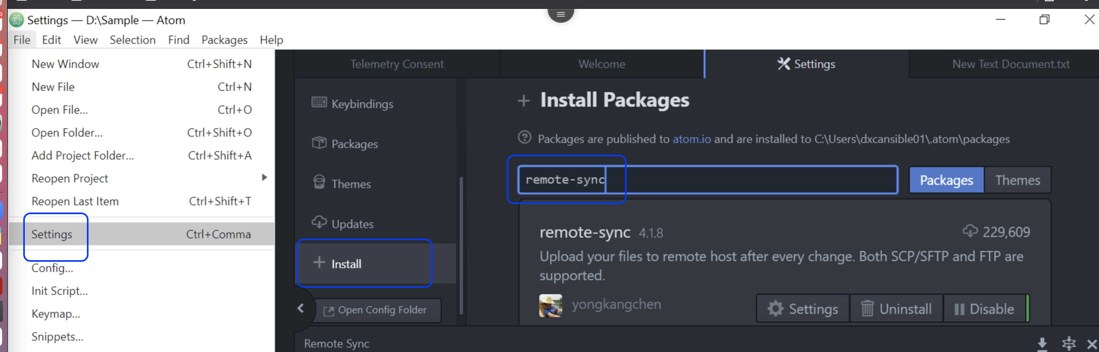
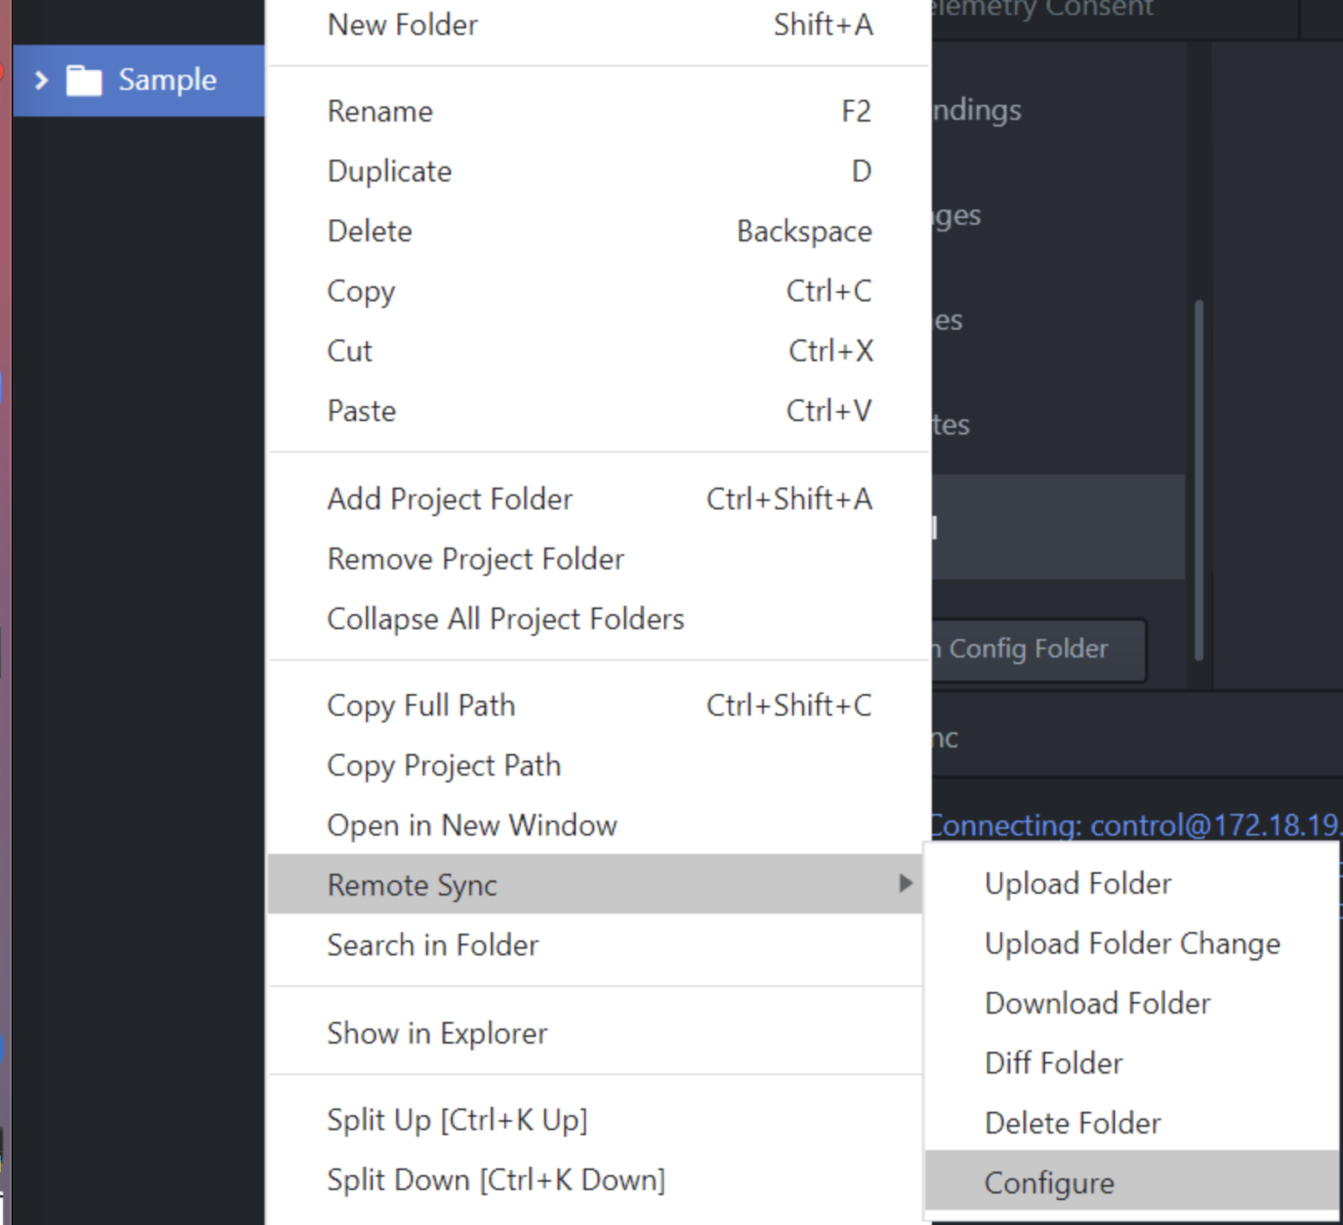
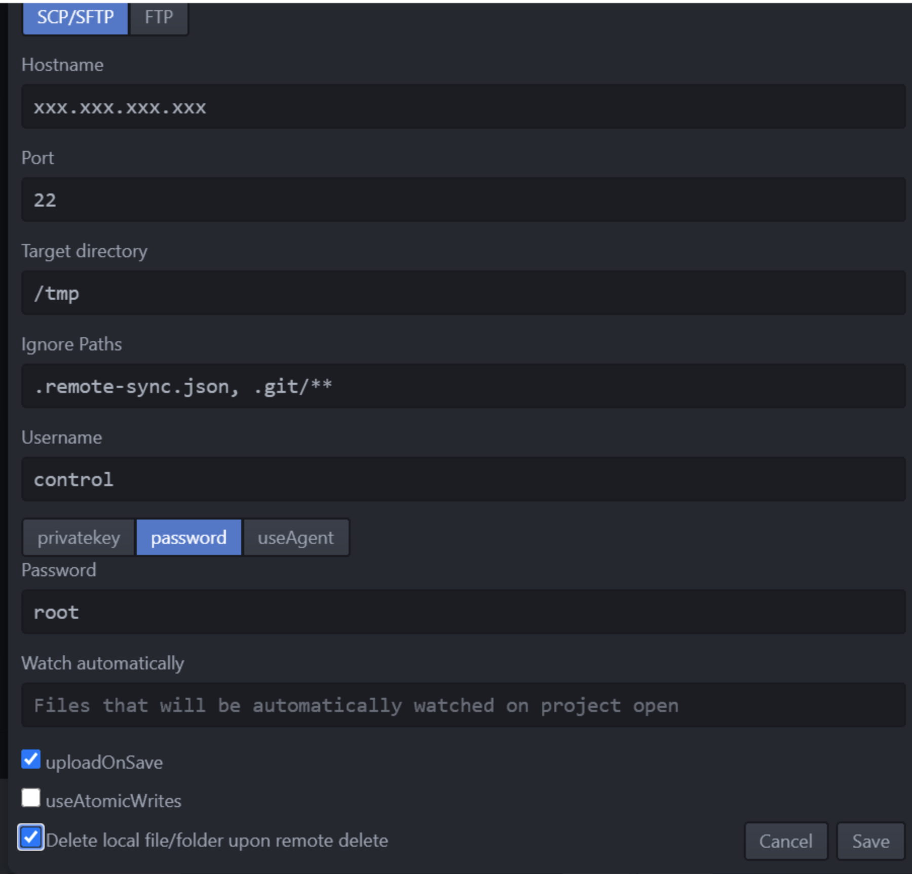
Install Atom IDE and configure remote sync

Slide 6

Prerequisites
Control Node prerequisites :
Python 2 (version 2.7) or Python 3 (versions 3.5 and higher).
SSHPASS
Windows isn’t supported for the control node.
Target Node prerequisites :
Python 2 (version 2.7) or Python 3 (versions 3.5 and higher).
SSH should be up and running.
If that’s not available, you can switch to SCP in [ansible.cfg],

Slide 7
Types of Installation
Installation can be done in 2 ways
Through Package Manager [Yum]
Through Python PIP installer

Slide 8

Through YUM
Installing Ansible through package manager such as YUM :
If incase you machine is RHEL [7&8], You need to enable repos :
subscription-manager repos --enable ansible-2.9-for-rhel-8-x86_64-rpms
subscription-manager repos --enable rhel-7-server-ansible-2.9-rpms
Centos :
Setup “epel” repo to install Ansible
yum install https://dl.fedoraproject.org/pub/epel/epel-release-latest-8.noarch.rpm
yum install https://dl.fedoraproject.org/pub/epel/epel-release-latest-7.noarch.rpm
Install using root :
yum install ansible
Install from non-root user :
sudo yum install ansible

Slide 9

Ubuntu distribution
Installing Ansible through package manager such as APT :
Install using root :
apt update
apt install software-properties-common
apt-add-repository --yes --update ppa:ansible/ansible
apt install ansible
Install from non-root user :
sudo apt update
sudo apt install software-properties-common
sudo apt-add-repository --yes --update ppa:ansible/ansible
sudo apt install ansible

Slide 10
Install Ansible through Python PIP
Using PIP module you can install Ansible.
First Install pip package [if it is not available]
yum install python3-pip
Then install the ansible package using PIP
pip3 install ansible
Note : Both yum & pip is going to install ansible under root directories, You can see that using commands
ansible-config –version (or) ansible --version
What if you want to install ansible under customized directory ?
For this you need to use python virtual environment.

Slide 11
Install Ansible under virtual environment
What is Virtual Environment ?
Virtualenv is used to manage Python packages for different projects.
Virtualenv allows you to avoid installing Python packages globally which could brake system tools or other projects.
Configure Virtual Environment in your custom directory.
Install virtual env using pip [if its is not there]
pip3 install virtualenv
virtualenv ansible
source ansible/bin/activate
pip3 install ansible
ansible –version (or) ansible-config --version

Slide 12
Install SSH Pass
yum install -y https://dl.fedoraproject.org/pub/epel/epel-release-latest-7.noarch.rpm
yum-configuration-manager --enable epel
yum install sshpass
Use of SSHPASS is to enable non-interactive SSH connections

Slide 13
Exploring Ansible Configuration file
Creating/Managing Ansible configuration file :
If installing ansible from a package manager, the latest ansible.cfg file should be present in /etc/ansible.
If you installed ansible from pip or from source, you may want to create this file in order to override default settings in ansible an example file available in Github
You can get all this details by using command
ansible-config –version
Major things to notice in configuration file :
Your default hosts directory if you install it through YUM :
inventory = /etc/ansible/*
It can be modified based on your requirement.

Slide 14
Ansible cfg
The default Ansible configuration file is located under /etc/ansible/ansible.cfg. Most of Ansible’s settings can be modified using this configuration file to meet the needs of your environment.
Ansible searches for configuration files in the following order, processing the first file it finds and ignoring the rest:
1. $ANSIBLE_CONFIG if the environment variable is set.
2. ansible.cfg if it’s in the current directory.
3. ~/.ansible.cfg if it’s in the user’s home directory.
4. /etc/ansible/ansible.cfg, the default config file.

Slide 15
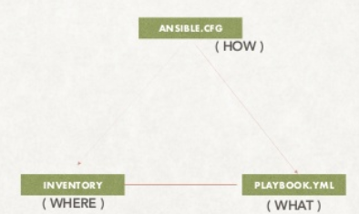
How, What & Where?
This image clearly shows how ansible works.
ANSIBLE.CFG file is going to instruct ansible how to work.
PLAYBOOK is to hold the instructions of what to do.
INVENTORY has the information of where to do.

Slide 16

End of this topic !
Any questions?

